Slide 1
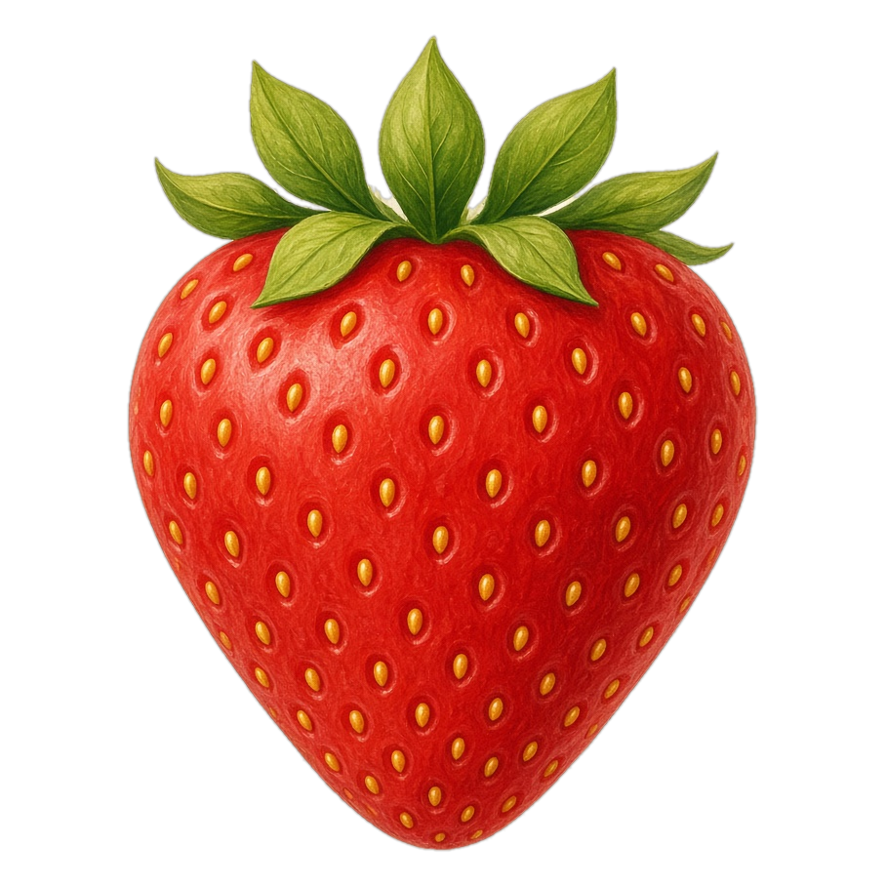
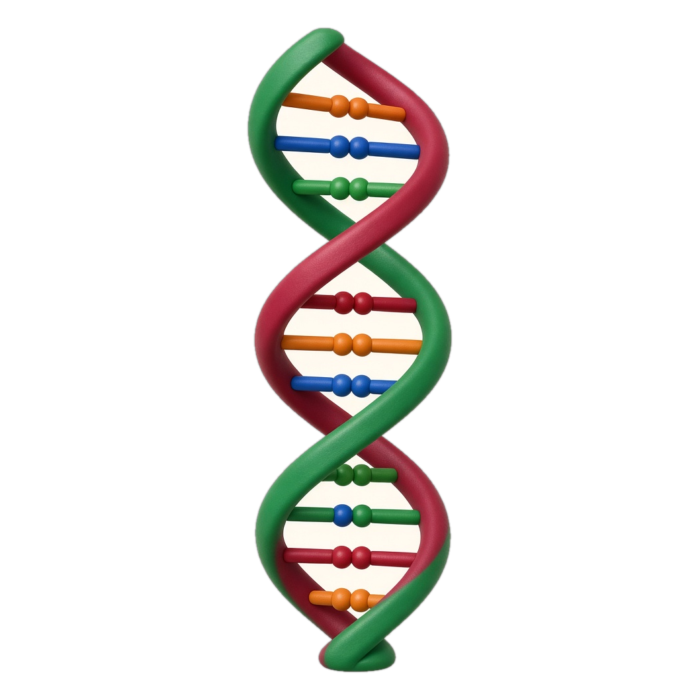
SCIENCE FAIR PROJECT
Strawberry DNA
Extraction
Pulling DNA out of a strawberry
with soap, salt, and cold alcohol.
Finley Grace DiAntonio
SOAP
SALT
COLD ALCOHOL
Breaks the cells open
Separates the DNA
Makes the DNA visible
All living things have DNA. This experiment makes strawberry DNA visible.
Notes:
Mount at the top of the CENTER panel. Print landscape, letter, actual size.

Slide 2
Question
Finley Grace DiAntonio
Can we extract DNA from a strawberry
using household supplies?
1
2
3
IN EVERY CELL
THOUSANDS OF CELLS
HOUSEHOLD SUPPLIES
DNA is the instruction molecule inside every living thing, including a strawberry.
DNA in one cell is too small to see. A mashed strawberry releases DNA from thousands of cells.
The test uses only soap, salt, and cold alcohol. If they work, the DNA should show up.
Notes:
Mount on the LEFT panel, top.

Slide 3
Hypothesis
Finley Grace DiAntonio
MY PREDICTION
I predict that soap, salt, and cold alcohol
will help us see strawberry DNA.
SOAP
SALT
COLD ALCOHOL
Breaks open the strawberry cells and lets the DNA out.
Helps keep proteins separate from the DNA.
Makes the DNA clump into strands we can see.
Notes:
Mount on the LEFT panel, under Question.

Slide 4
Research and Sources
Finley Grace DiAntonio
WHAT DNA IS
WHY A STRAWBERRY?
DNA stands for deoxyribonucleic acid.
Shape. It is a long molecule in a double helix — two spirals, like a twisted ladder.
Sides. Sugars and phosphates make the backbone of each spiral.
Rungs. Four bases connect the spirals: adenine (A), thymine (T), guanine (G), and cytosine (C).
Job. Genes are made of DNA. It holds the instructions for making proteins, like a recipe book for a living thing.
• Strawberry cells are soft and easy to mash open.
• Each cell has eight copies of its DNA, so there is a lot to collect.
• DNA from thousands of cells can be seen without a microscope.
WHY THESE SUPPLIES?
• Dish soap bursts the cells open and releases the DNA.
• Salt keeps the proteins separate from the DNA.
• DNA does not dissolve in cold alcohol, so the strands clump and become visible.
A
T
G
C
Adenine
Thymine
Guanine
Cytosine
SOURCE
A always pairs with T.
G always pairs with C.
Strawberry DNA Extraction
Institute for Molecular Bioscience
The University of Queensland
www.imb.uq.edu.au
All living things have DNA — people, plants, animals, and strawberries.
Notes:
Mount on the LEFT panel, under Hypothesis.

Slide 5
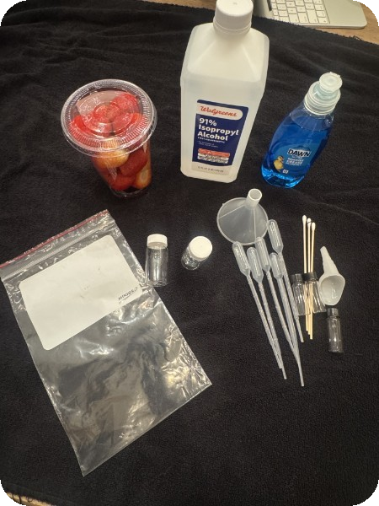
Materials
Finley Grace DiAntonio
1
Strawberries
7
Gauze or coffee filter
OUR SUPPLIES
The cells the DNA comes from
Strains out the solids
2
Zip-close sandwich bag
8
Rubber band
For mashing without a mess
Holds the filter on the cup
3
Dish soap
9
Test tube or small cup
Bursts the cells open
Where the DNA shows up
4
Table salt
10
Spoon or dropper
Separates DNA from proteins
Moves the liquid and the alcohol
5
Water
11
Cold rubbing alcohol
The base of the extracting solution
Kept in the freezer until use
6
Plastic cup
12
Paper towels
Catches the filtered liquid
For spills and cleanup
MIX THIS FIRST
DNA extracting solution
1 tablespoon
1 teaspoon
1 cup
dish soap
salt
water
Notes:
Mount on the CENTER panel, under the title.

Slide 6
Procedure
Finley Grace DiAntonio
Use 2 tablespoons of the DNA extracting solution from the Materials list.
Seal one strawberry in a zip-close bag. Push out most of the air.
Mash it gently in your hand. Do not pound the bag on the table.
Add 2 tablespoons of the DNA extracting solution.
1
2
3
Keep mashing until the strawberry looks soupy.
Cover a cup with gauze or a coffee filter. Hold it with a rubber band.
Pour the mixture through so only the liquid goes into the cup.
4
5
6
Spoon some liquid into a clear test tube or small cup.
Add a spoonful of cold alcohol. Do not tilt the tube or mix.
Watch the line where the strawberry liquid meets the alcohol.
7
8
9
ADULT HELP
Ask an adult to pour the alcohol. Do not drink it. Keep it in the freezer until you use it. Pounding the bag can break the DNA.
Notes:
Mount on the CENTER panel, under Materials.

Slide 7
Results
Finley Grace DiAntonio
IN THE TUBE
Two layers
1
The strawberry liquid stayed on the bottom. The cold alcohol stayed on top.
Cold alcohol
Top layer
A white cloud
2
A white, thread-like cloud formed on the line where the two liquids met.
DNA
White strands
Strawberry liquid
It floats up
Bottom layer
The threads clumped together and rose into the alcohol layer.
3
This is the DNA
The two liquids stay apart.
The DNA appears on the line between them.
That white cloud is strawberry DNA, gathered from thousands of cells.
4
Notes:
Mount on the RIGHT panel, top. Tape a photo of your tube beside this sheet if you have one.

Slide 8
Conclusion
Finley Grace DiAntonio
My hypothesis was supported.
I predicted that soap, salt, and cold alcohol would help us see strawberry DNA. The white, thread-like strands in the alcohol showed that this happened.
WHAT I LEARNED
SOAP
SALT
Soap breaks the cell membrane, the outer layer of each cell, so the DNA can spill out.
Salt helps keep the DNA separate from the proteins that were packed in the cell with it.
COLD ALCOHOL
THE BIG IDEA
DNA does not dissolve in cold alcohol, so the strands clump into a cloud we can see.
DNA is in every living thing. Household supplies can make the DNA inside a strawberry visible.
Notes:
Mount on the RIGHT panel, under Results.

